Slide 1
VR Art gallery

Slide 2
Design Brief
Our goal is to make a VR art gallery, in Unity that makes use of the oculus rift and it’s hand controllers. This needs to be done while making it accessible to people with disabilities and also being inclusive with all types of people. We also need to make it intuitive to the user making it easy to pick up. The due date for this project is the 28th of May.

Slide 3
Investigation
Search / Source / Capture artwork
Evidence of similar VR experiences
The real environment - capture textures and discuss the location for an art exhibition
Hardware and Software - Provide some information on the software and hardware to be utilised to build the experience and how it works together:
Basic computer specs for an Oculus ready pc
Oculus Rift Headset and Handset
Unity 3D

Slide 4
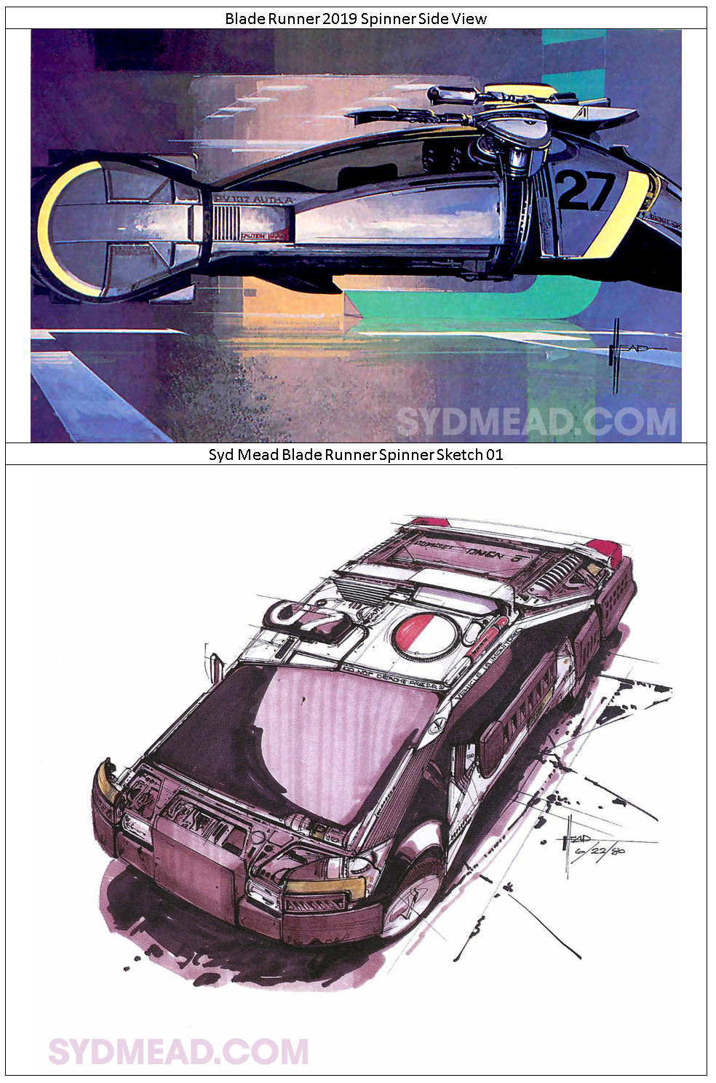
Investigation
Search / Source / Capture artwork

Slide 5
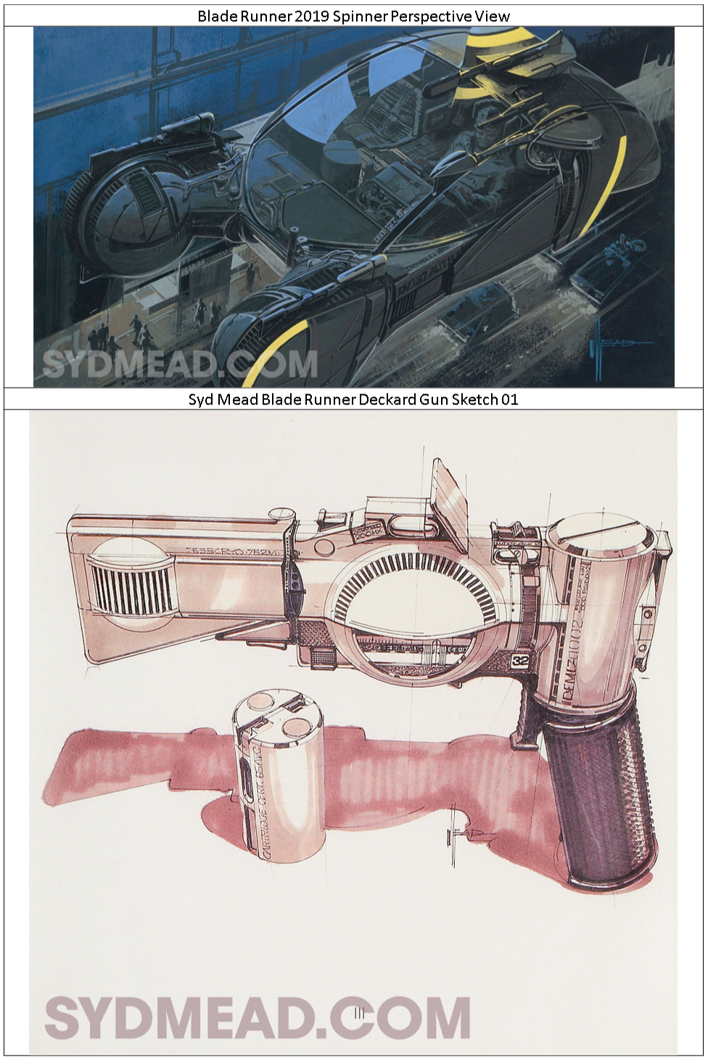
Investigation
Search / Source / Capture artwork

Slide 6
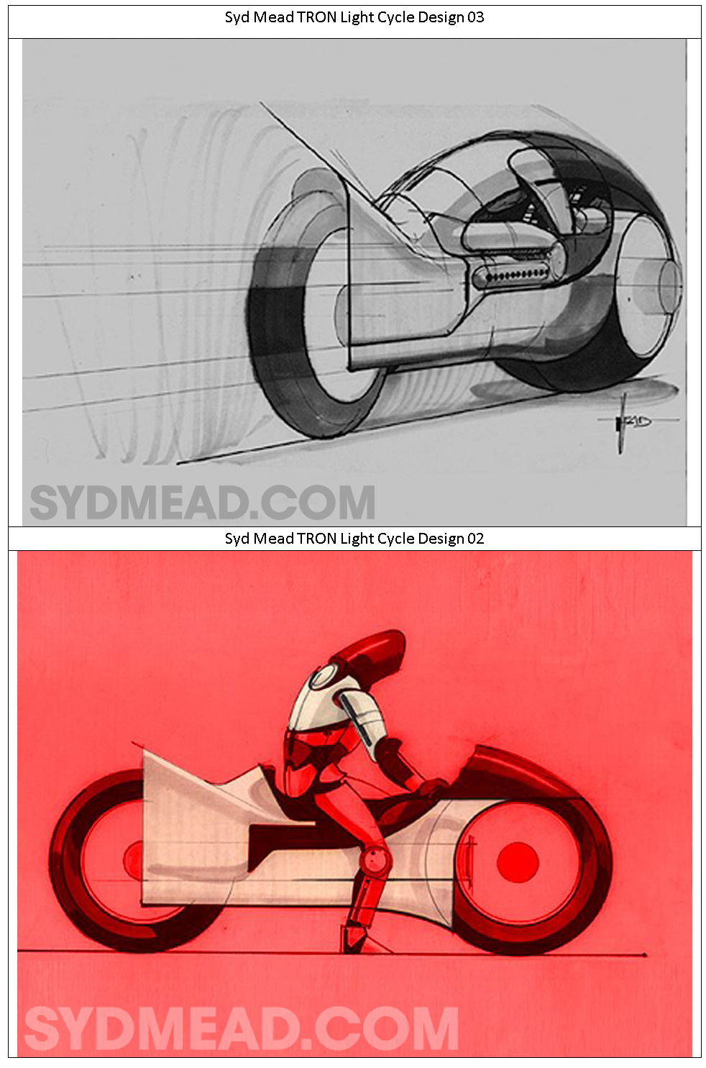
Investigation
Search / Source / Capture artwork

Slide 7
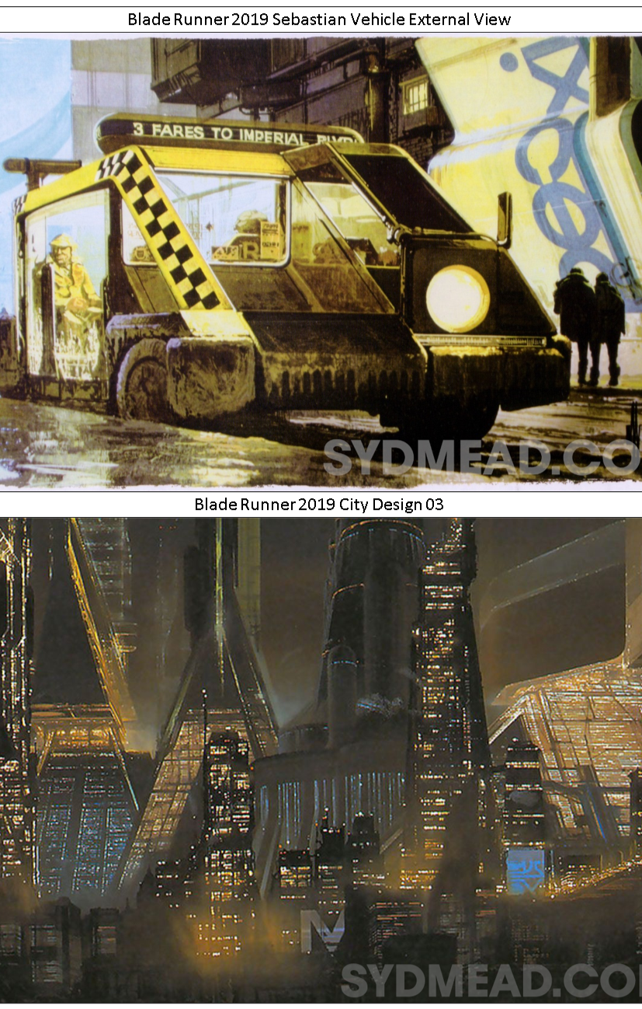
Investigation
Search / Source / Capture artwork

Slide 8
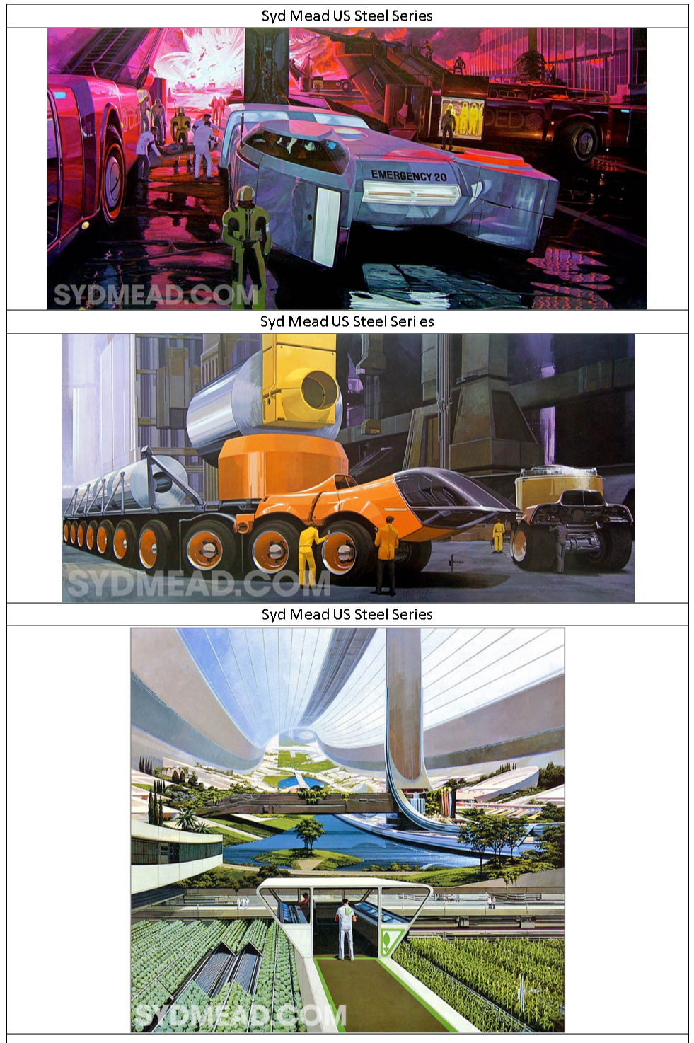
Investigation
Search / Source / Capture artwork

Slide 9
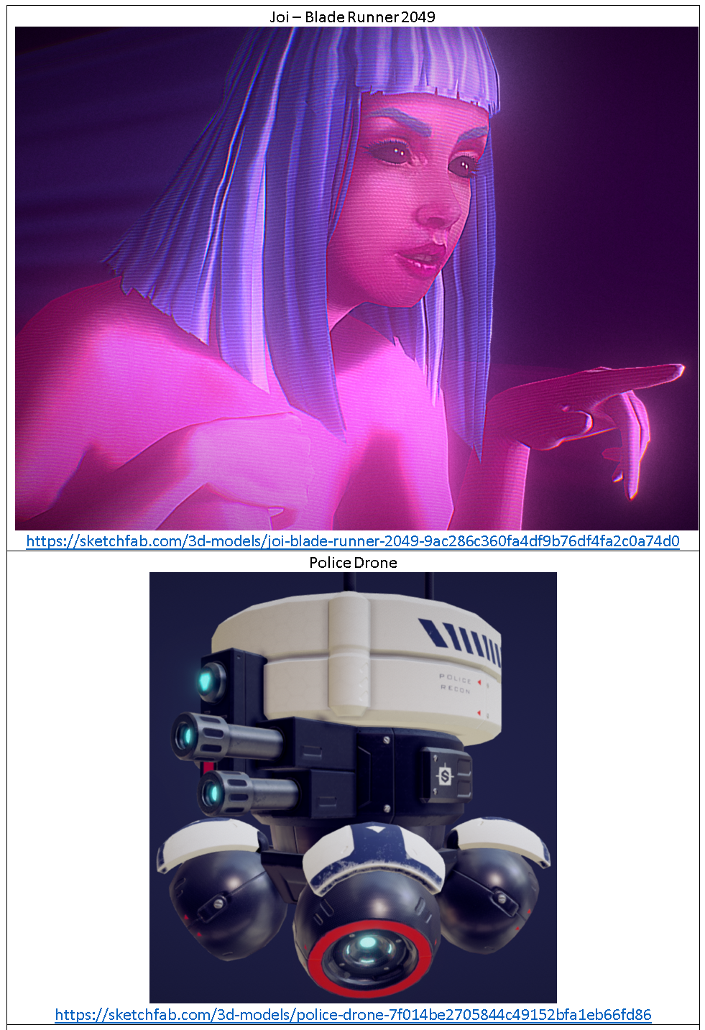
Investigation
Search / Source / Capture artwork

Slide 10
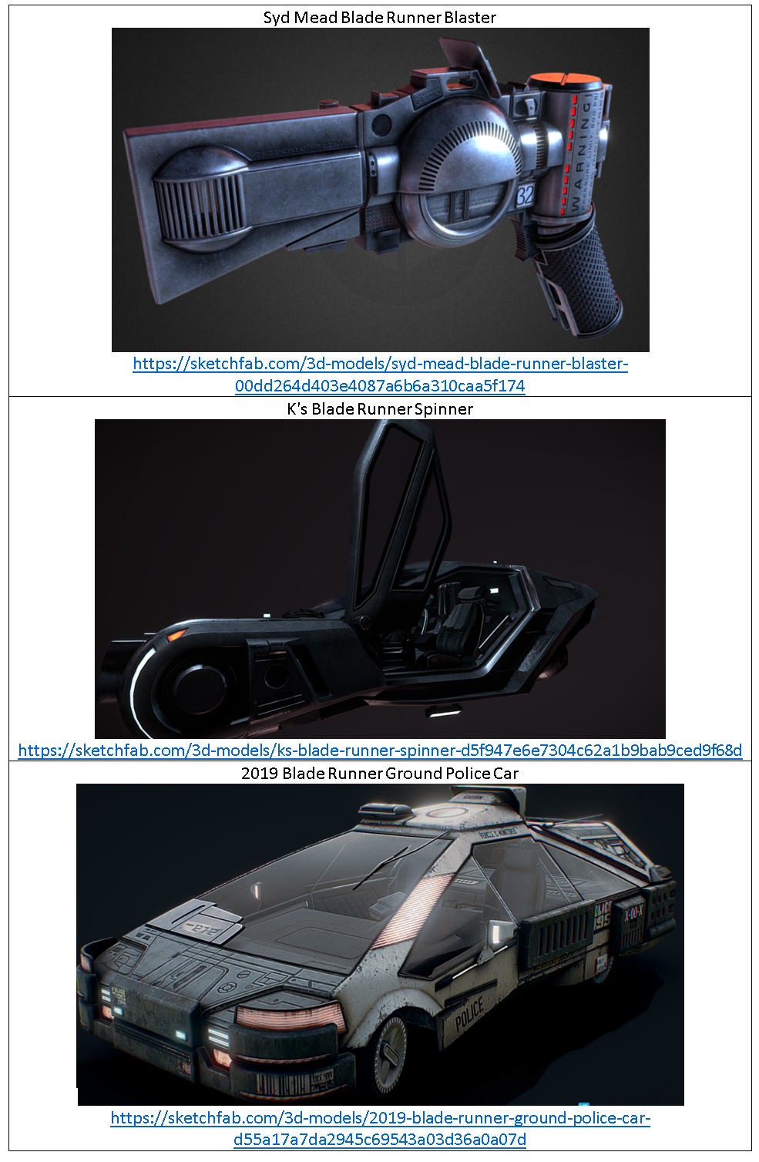
Investigation
Search / Source / Capture artwork

Slide 11
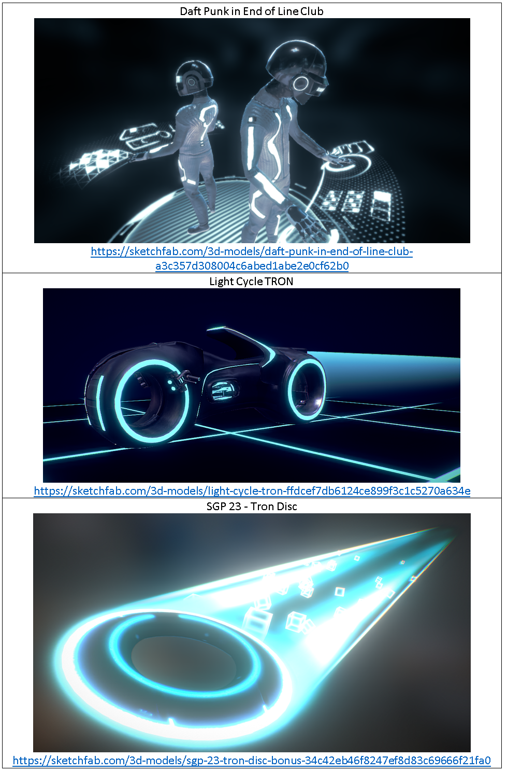
Investigation
Search / Source / Capture artwork

Slide 12
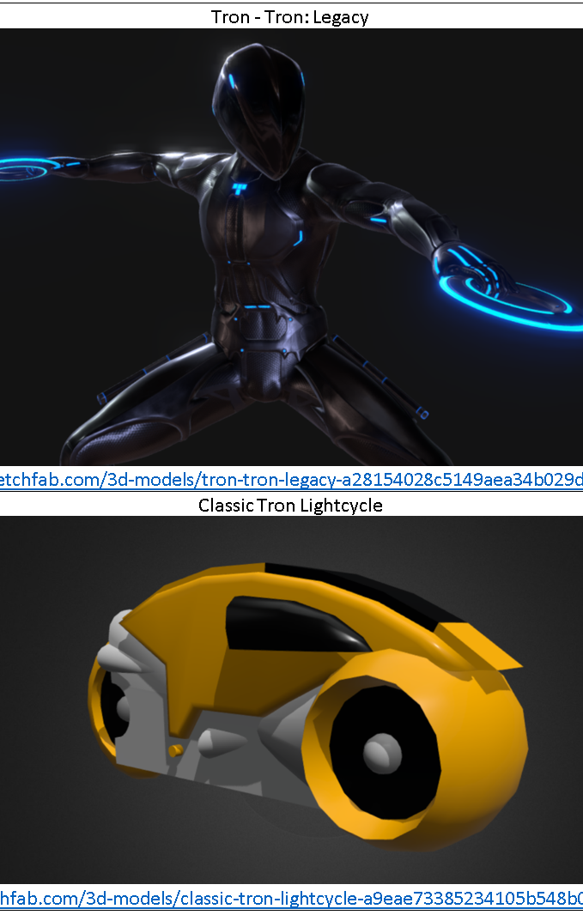
Investigation
Search / Source / Capture artwork

Slide 13
Investigation
Evidence of similar VR experiences
There are many notable ones but the most popular one is:
https://vrartgallery.org/

Slide 14
Investigation
The real environment - capture textures and discuss the location for an art exhibition.
For this project we used the memorial hall as the location for the VR experience as it has a sense of familiarity while also a brand new experience with what is located inside of the memorial hall

Slide 15
Investigation
Hardware and Software - Provide some information on the software and hardware to be utilised to build the experience and how it works together.
For this project we will be using a computer with the basic specs for an Oculus rift ready pc, a Oculus Rift Headset and Handsets, we will be coding in C# and getting models and art off of the internet.

Slide 16
Target Audience
Facts - what are the known facts about you target audience? 14 – 30 as they have most likely seen his work, mostly English-speaking countries however if prior knowledge of English other companies.
Pains - what are the barriers to use of this product by the target audience? This requires a VR headset however this could be fixed by using something like openXR, if you aren’t much of a ‘nerd’ you’ll be less interested in partaking in it.
Goals - How can the target audience benefit or interact with the product this experience manages to provide an informative and enjoyable experience about Syd Mead.

Slide 17
Required Features / Design Criteria
Make is accessible to anyone that might want to go.
Use his original logo.
Use any design guids provided by the company and any other associated people of authority.
Make use of Elements and Principles of Design.
Make is aesthetically pleasing.

Slide 18
Gantt Chart

Slide 19
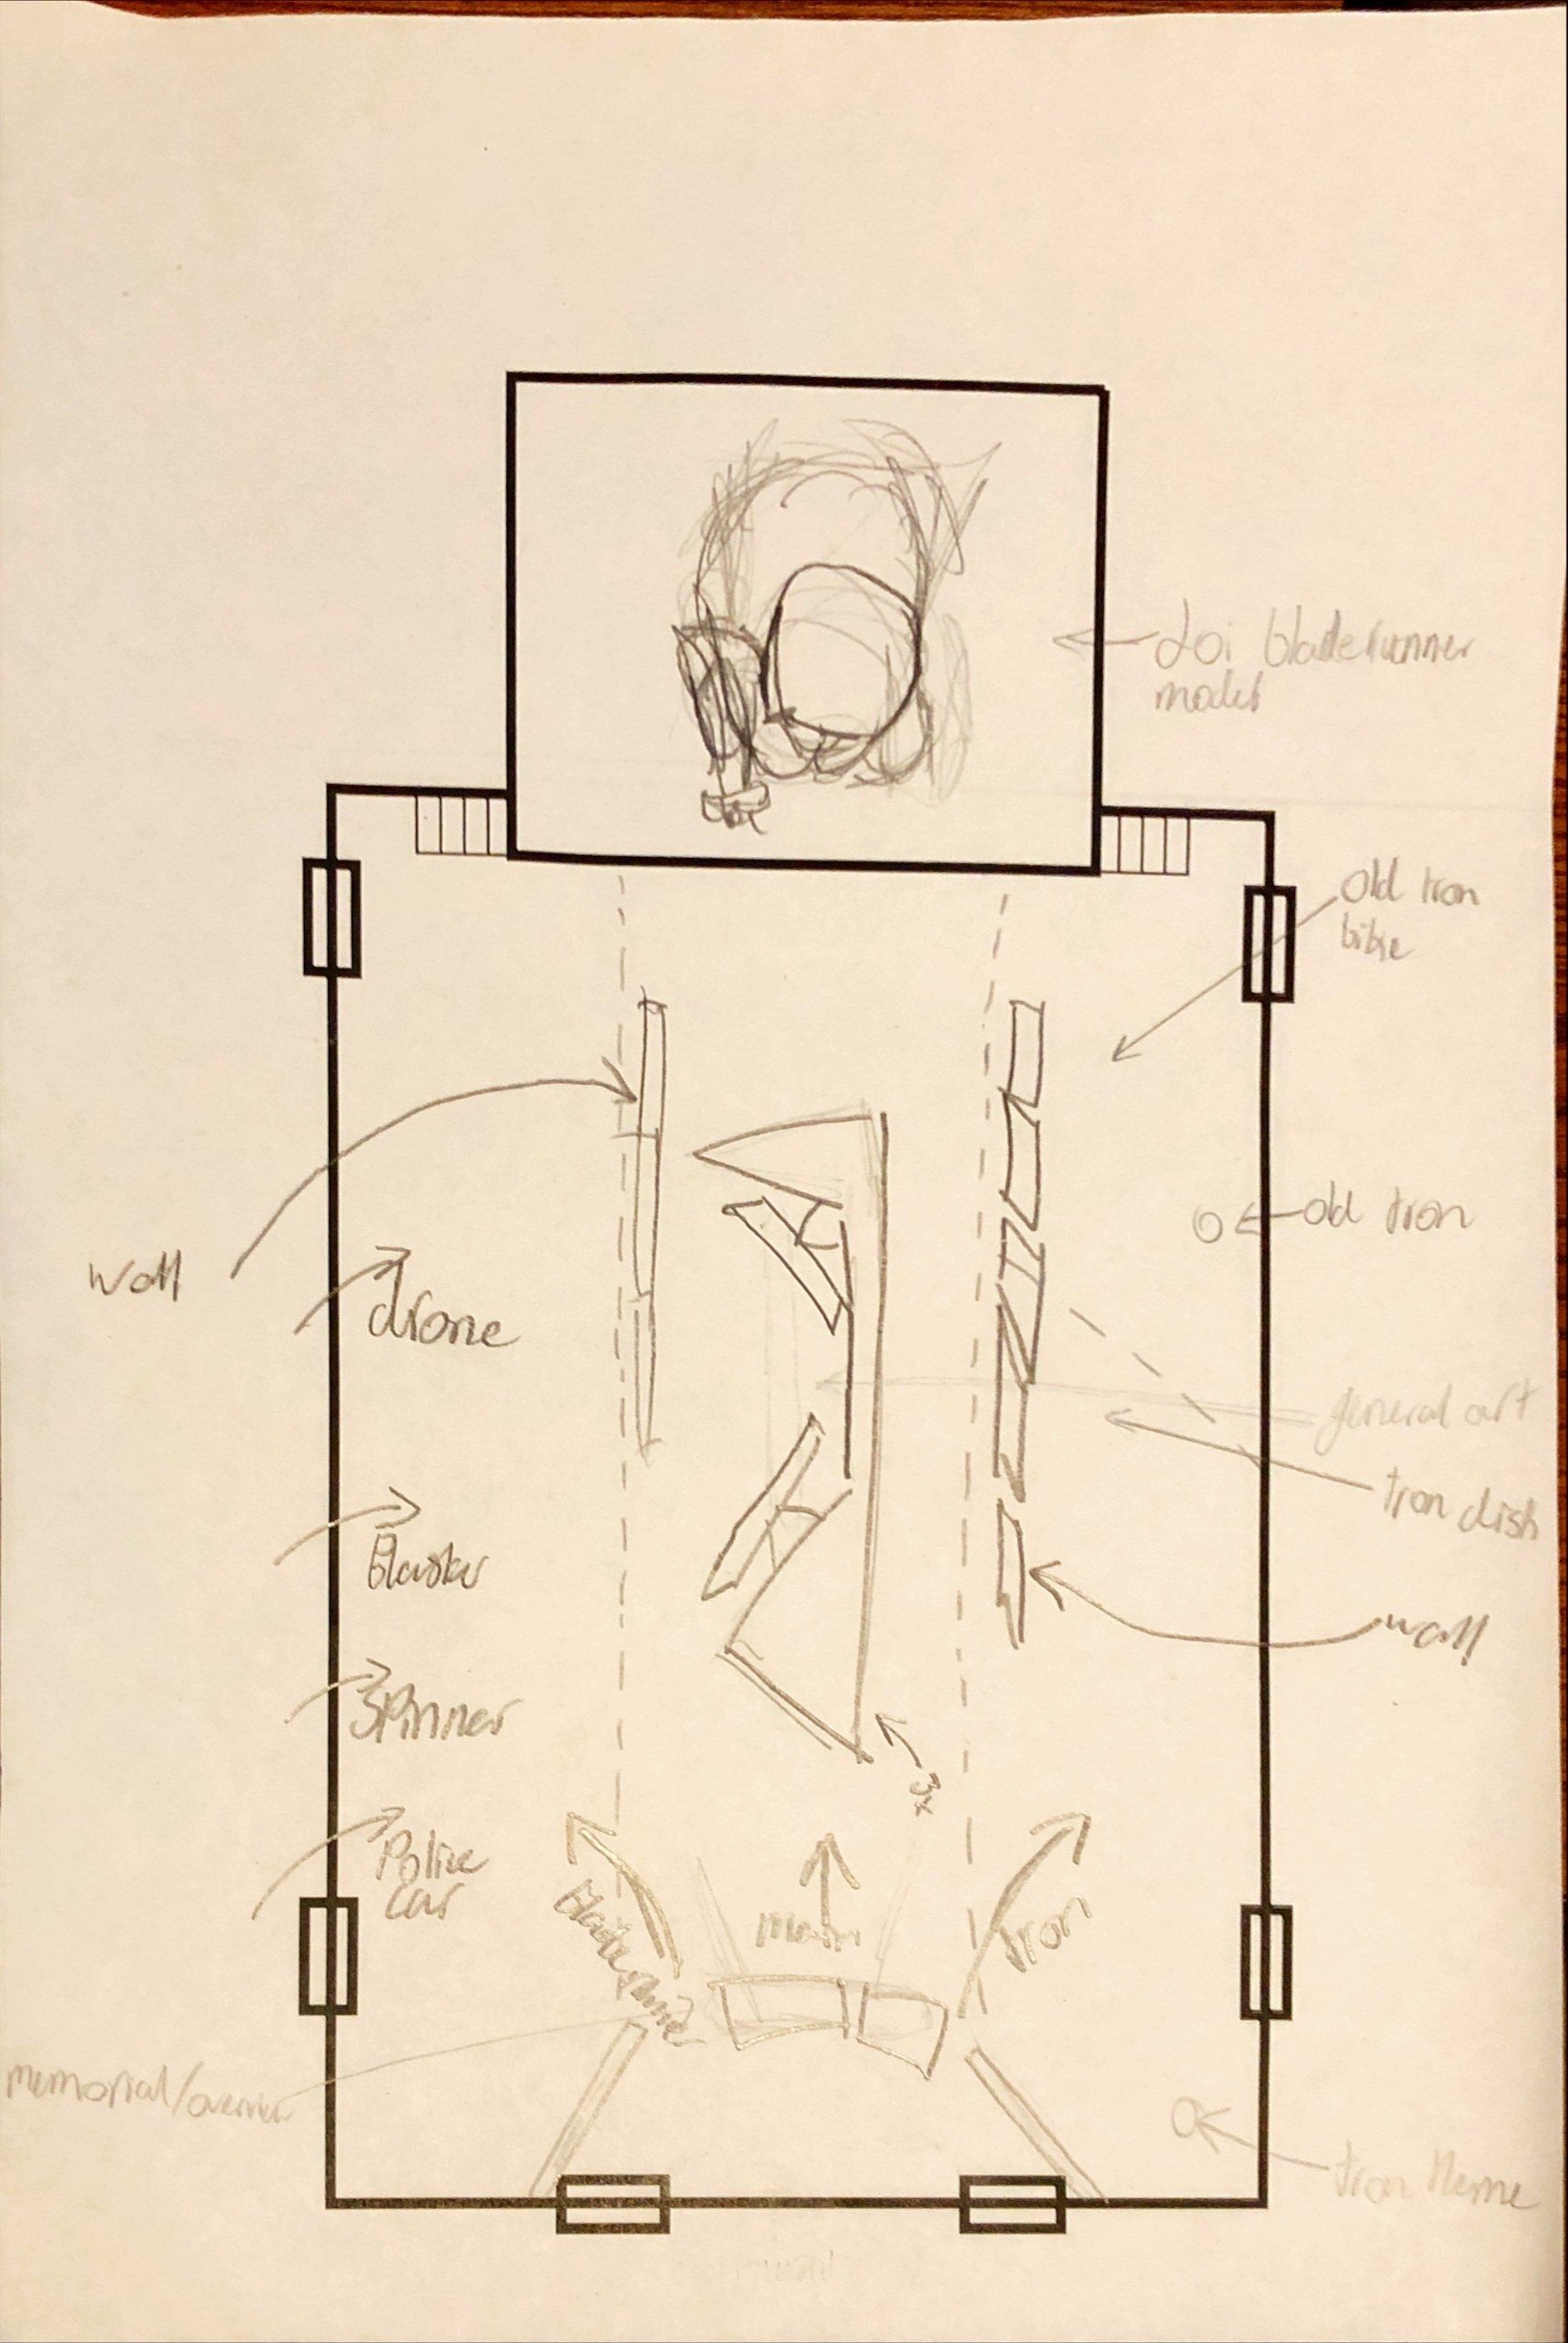
Sketches

Slide 20
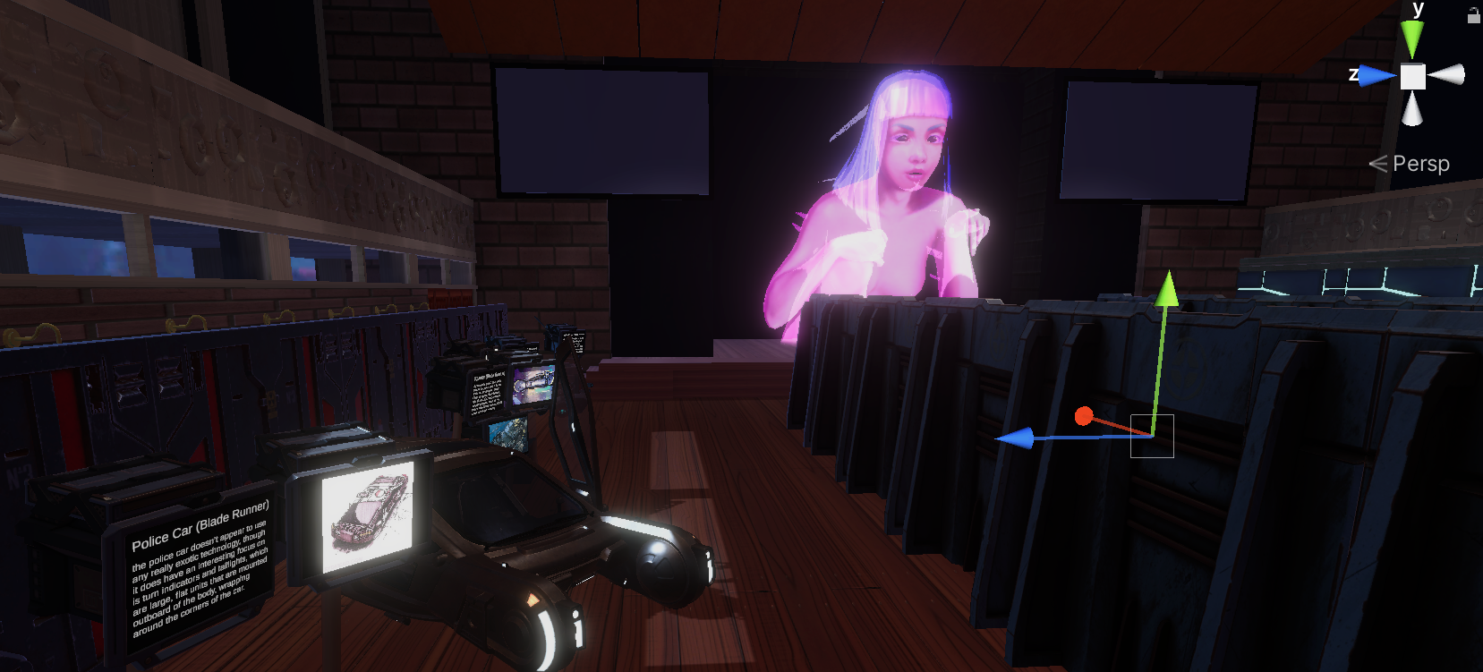
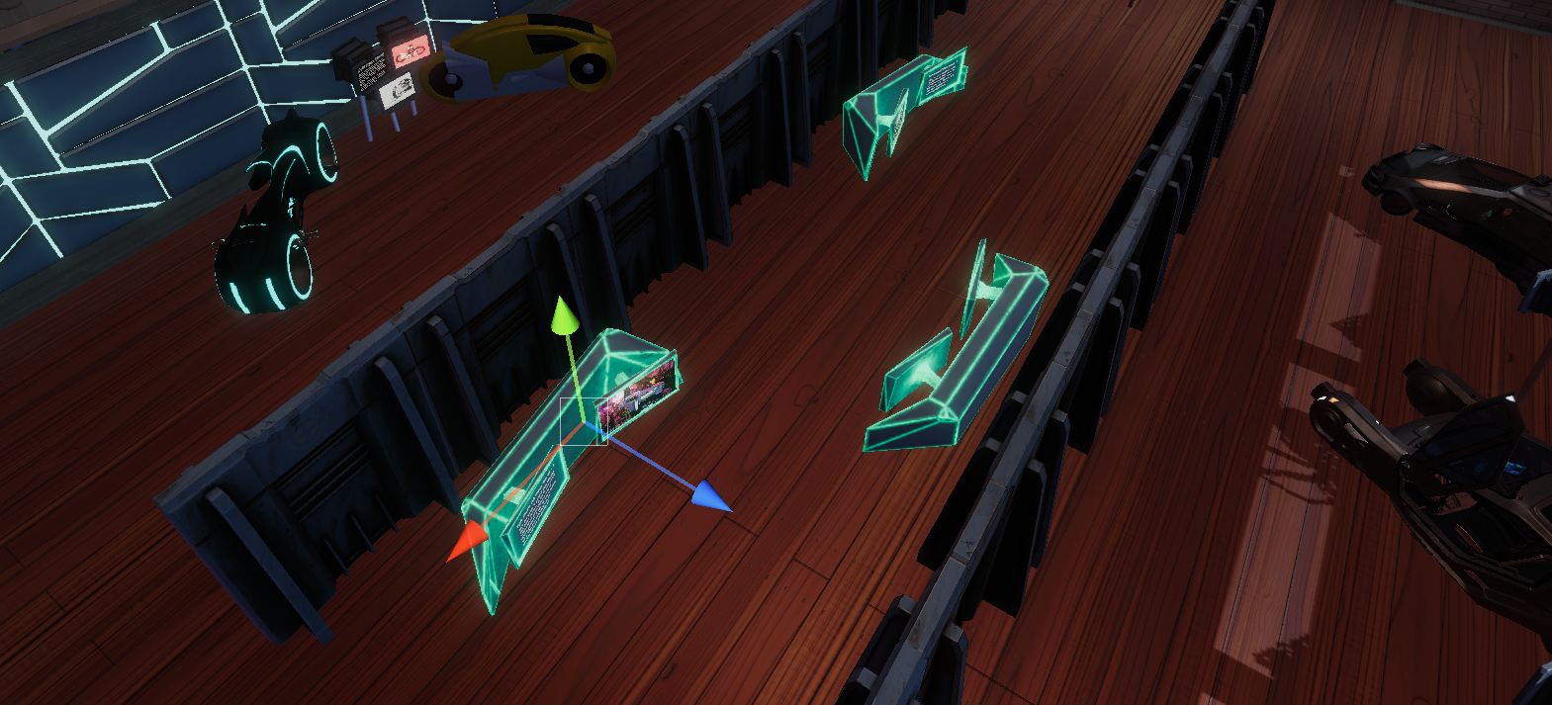
Unity build of the VR Experience

Slide 21
Development Evaluation
Overall the outcome of the project is acceptable when viewed from a outside perspective, however, when looking at it from what was previously envisioned there is still much that can be achieved, including:
A more dynamic environment.
More art.
More interactable.
More time spent on lighting rather than boosting the gamma.

Slide 22
User Evaluation
Questions | Oliver Robbson
How is the use of audio to cater to the Blind? | It is effective as it does do a good job at catering to the blind, however it is lacking in information in some places however this is only because of a lack of documentation as mentioned in certain places.
How is the use of both 3D models and 2D art? | It is effective providing a immersive merger of the two mediums providing both 3D models and 2D art works for certain things and when there isn’t 3D art the 2D art is appropriately displayed on monitors realistically.
How was the lay out? | The lay out of the art was good enough providing different zones for the art that the user can go between however it would have been nice to have more signage and models in the Tron zone.

